Slide 1


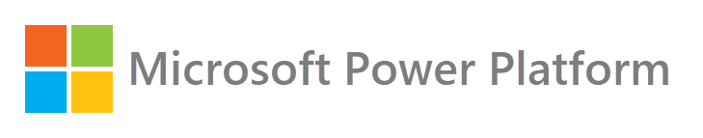


Hack@Speed – A Heartfelt Christmas Story
Chris Huntingford
Sr. Technical Architect
December 2020
Notes:
Hello and welcome to Power Platform in a Hurry.
Over the 60 minutes or so, we will go trough a comprehensive overview of Microsoft’s low-code / no-code platform including industry insights, market positioning, business value, functional architecture, governance and adoption, customer stories, licensing options and product roadmap.
This will not be a technical deep dive, but after this video you will be able to make an informed decision before you invest in this product and have the knowledge to successfully transform your organization with the Microsoft Power Platform.

Slide 2
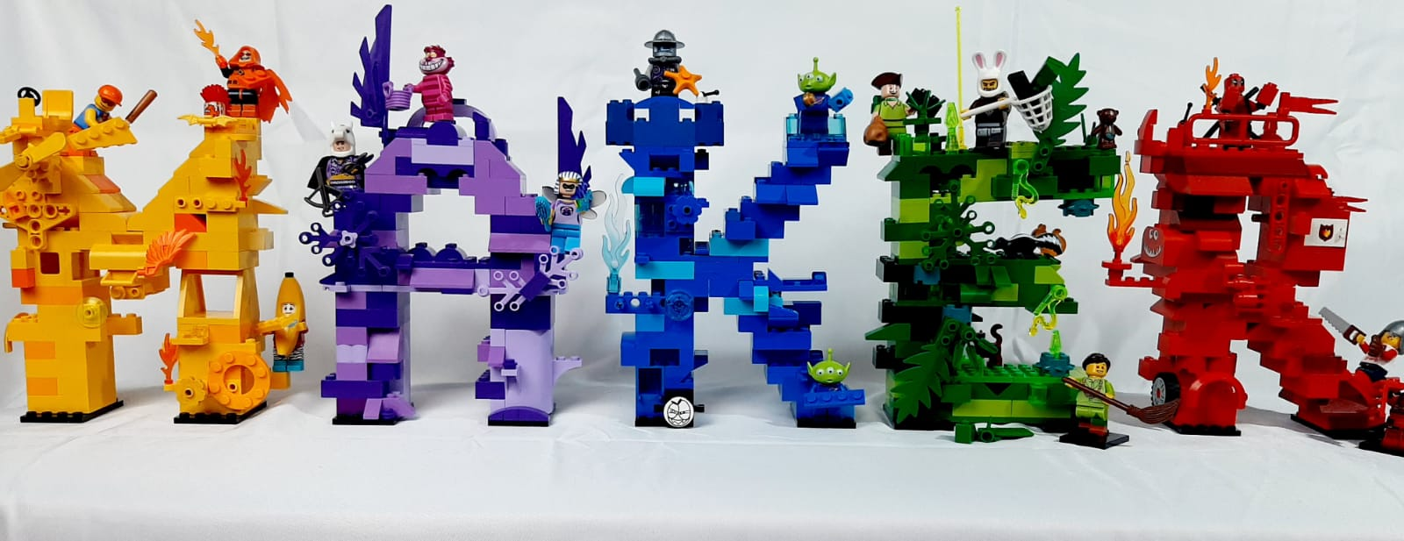

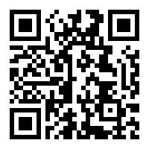


Let’s connect!
Chris Huntingford
Power Platform Technical Architect
Reading, UK
Scan the QR code or visit: aka.ms/ChrisH
Notes:
My name is Kym Dupuis, and my role at Microsoft is to help organizations to turn business expertise into solutions with ease using the Microsoft Power Platform. If you would like to connect on LinkedIn and have conversations specific to your organization, scan the QR code on your right.

Slide 3


Slide 4
Todays Agenda (Virtual)
Time | Session
08:30 – 08:50 | Opening Ceremony
08:50 – 09:20 | Meet Your Mentor / Team Session
09:20 – 10:20 | Challenges Deep Dive Session Connector Overview Session
10:20 – 10:30 | BREAK
10:30 – 11:45 | Master Class
11:45 – 12:15 | LUNCH
12:15 – 16:00 | Master Class
16:00 – 16:15 | BREAK
16:15 – 16:45 | Business Session by Scottish Enterprise
16:45 – 17:00 | Closing & Wrap-up

Slide 5

Power Platform Introduction

Slide 6
Digital transformation landscape
5X
500M
65%
Demand for mobile app will grow at least five times faster than IT capacity to deliver¹
In the next 5 years, 500 million new logical apps will be created, equal to the number built over the past 40 years².
By 2024, low-code application will be responsible for more than 65% of application dev. activity³
¹Source: Gartner, How to Deliver Enterprise Mobile Apps Faster 2017
²Source: International Data Corporation “IDC” FutureScape: Worldwide IT Industry 2019 Predictions
³Source: Gartner 2019 Magic Quadrant for Enterprise Low Code Application Platforms

Slide 7
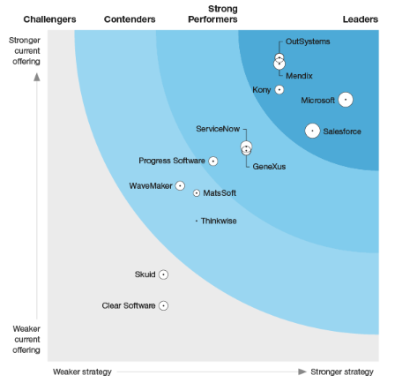
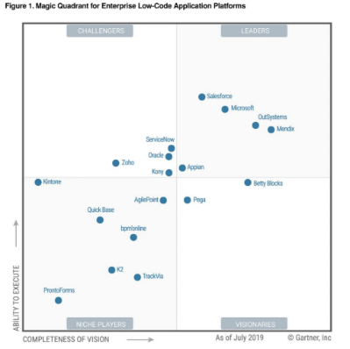

Power Platform momentum
“Microsoft 365, Dynamics 365, and the Power Platform, on top of what we’re doing with Azure, is the core of what we are doing as a company.” --Satya Nadella
>3.5M
Monthly Active Developers on the Power Platform
>700%
growth in Power Apps production apps in the last year
>300%
growth in Power Apps Monthly Active Users in the last year
Leader in the Forrester wave for Low Code Development Platforms for AD&D Pros
Leader in the Gartner MQ for Enterprise Low Code Application Platforms

Slide 8
Digital transformation motivations of many decision makers
“We need to go faster”
“We already have the data”
IT application development is gravitating towards low-code and high-productivity application platforms to minimize cost and support rapidly changing business needs.
Essential part of these high-productivity application platforms is that they natively integrate with existing business data – e.g., CRM or ERP systems and existing business process applications.

Slide 9
Digital transformation challenges
Budget
constraints
Time & Resource
constraints
Business
expectations
Paper
processes
Complex
processes
IT/Business
partnership
No BI integration
“Shadow IT”
governance
Tools to create the right culture
Security &
Compliance
Legacy system
maintenance
Difficult to find insights
Track & measure performance
Leverage existing
technology
Integrate data from the right sources

Slide 10
Digital transformation options
Off the shelf SaaS solutions are a great starting point for out of the box use cases but lack the flexibility to solve other custom business needs.
Custom development is great to build very specific business solutions but usually takes longer and has limited upgradability.
Many business processes still rely on spreadsheets, manual processes and Shadow IT that do not comply with security and regulations.

Slide 11






Power Platform overview
Power BI
Business analytics
Power Apps
Application development
Power Automate
Process automation
Power Virtual Agents
Intelligent virtual agents
Canvas Apps
Microsoft Flows
Model-driven Apps
Business Process Flows
Portals
UI Flows (RPA)
Data connectors
Common Data
Service
AI Builder
Center of Excellence (Governance, Compliance & Security)
Notes:
.

Slide 12

Logo
Microsoft mission
Empower every person and every organization on the planet to achieve more

Slide 13

Hack@Speed Introduction

Slide 14
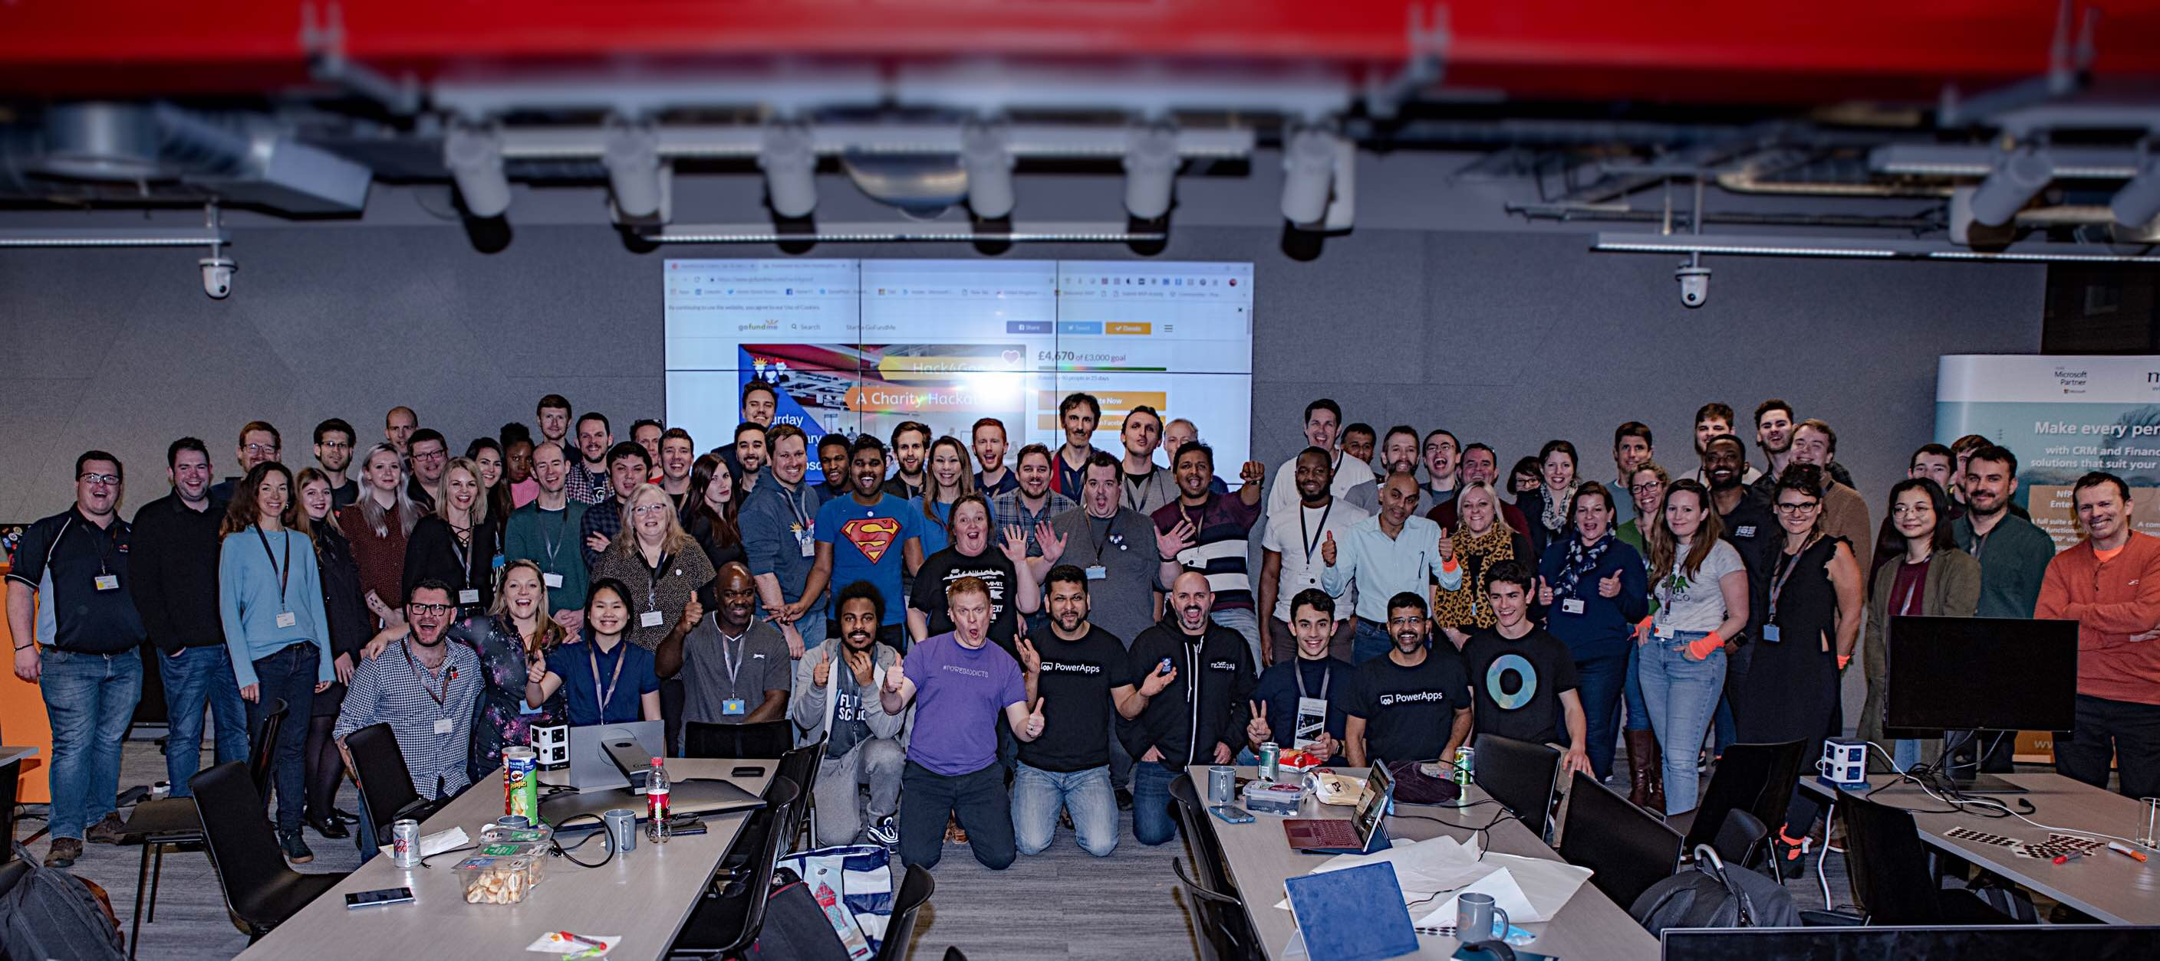


Hack@Speed
Notes:
Hack@Speed originally came from various sessions done within the Power Platform Community. The content and use cases come directly from live demo builds done over a number of community and customer events. These have been consolidated into “HackPacks” which can be leveraged by anyone building solutions within the Hack@Speed event and outside of this for demonstration purposes.

Slide 15
The Goal
Our goal during this event is to drive enthusiasm & creativity through a combination of technology and problem solving skills.
Technology can be learnt by anyone, no matter who you are and with Hack@Speed, we wanted to give everyone an opportunity to have fun and get involved.

Slide 16










Different Hack Packs
Healthcare
Prospects
Central Gov.
Local Gov.
UFO Sightings
Financial
Sleigh Sightings
Recruitment

Slide 17




Hack Options
Lab Style Hack
Get Creative
Double or Nothing
Dream
Team
Notes:
Lab Style Hack
Follow the “Power Platform Hack@Speed PDF focusing on the Prospects data. Complete all of the labs following the instructions as they are. If you can, step outside the lines a bit and be creative if possible.
Get Creative
The Hack Packs contain data that is very similar in type. You can use the Hack@Speed PDF as a guide and leverage the data from the various hack packs. You will need to use your interpretation skills here as not everything will be click for click replicated in the manual.
Double or Nothing
Couple up and split the work. Decide on the use case (Run the Lab, Use the hack packs or bring your own data) and build something amazing.
Dream Team
Get a team together, decide on the way you want to hack and build something AMAZING using your own data or the data from the Hack Packs.

Slide 18
Hack Assets
A username & Password that will get you into your environment
The Introduction / Prerequisite document
The Sleigh Sightings Lab Documents
AKA.MS/HASSleighSightings
Notes:
Lab Style Hack
Follow the “Power Platform Hack@Speed PDF focusing on the Prospects data. Complete all of the labs following the instructions as they are. If you can, step outside the lines a bit and be creative if possible.
Get Creative
The Hack Packs contain data that is very similar in type. You can use the Hack@Speed PDF as a guide and leverage the data from the various hack packs. You will need to use your interpretation skills here as not everything will be click for click replicated in the manual.
Double or Nothing
Couple up and split the work. Decide on the use case (Run the Lab, Use the hack packs or bring your own data) and build something amazing.
Dream Team
Get a team together, decide on the way you want to hack and build something AMAZING using your own data or the data from the Hack Packs.

Slide 19
Logistics for the Day
We will all stay on this main Teams call and run through the Labs.
If you need help, please let us know and one of our Elves will contact you in the chat.
If you need further help, you will be directed to a private channel for a chat.
Introductions to various modules will be done roughly every 45 min live in this channel. Feel free to mute me :D
Notes:
Lab Style Hack
Follow the “Power Platform Hack@Speed PDF focusing on the Prospects data. Complete all of the labs following the instructions as they are. If you can, step outside the lines a bit and be creative if possible.
Get Creative
The Hack Packs contain data that is very similar in type. You can use the Hack@Speed PDF as a guide and leverage the data from the various hack packs. You will need to use your interpretation skills here as not everything will be click for click replicated in the manual.
Double or Nothing
Couple up and split the work. Decide on the use case (Run the Lab, Use the hack packs or bring your own data) and build something amazing.
Dream Team
Get a team together, decide on the way you want to hack and build something AMAZING using your own data or the data from the Hack Packs.

Slide 20

Solution Build

Slide 21

Introducing “Sleigh What” Systems

Slide 22

The Use Case
“Sleigh What” are storing their data in spread sheets and have no way of tracking all of the urgent sightings that are logged.
Sightings data is sensitive and regulated by the elves. Its important to make sure that all sightings are tracked in a centralised location and can be taken through a sighting process to completion in a regulated way.
Elves in black need to be notified of all sightings as soon as they take place.
The sightings need to be shared with the elves in black via a report so that they can understand where the sightings are coming from. The elves in black will leverage a mobile app when they visit the specific parties and will use memory erasing magic to clear all knowledge of the sleigh sighting.

Slide 23

Elves in Black

Slide 24
Use Case Breakdown
“Sleigh What” are storing their data in spread sheets and have no way of tracking all of the urgent sightings that are logged.
Sightings data is sensitive and regulated by the elves. Its important to make sure that all sightings are tracked in a centralised location and can be taken through a sighting process to completion in a regulated way.
Elves in black need to be notified of all sightings as soon as they take place.
The sightings need to be shared with the elves in black via a report so that they can understand where the sightings are coming from. The elves in black will leverage a mobile app when they visit the specific parties and will use memory erasing magic to clear all knowledge of the sleigh sighting.

Slide 25



Alert User via Email
Record Management Process
Record Management Canvas App
Record Management Model App
Power Apps
Dataverse
Custom Entity
Data
Views
Graphs
Dashboards
Forms
AI Builder
Data Management Report

Slide 26

Power Platform Demonstration & How to Hack

Slide 27

Dataverse
Notes:
Moving on to Power Automate, the automate side of the power platform, this is a platform that you may have heard of at it was previously known as Microsoft Flow. It lets you create automatic workflows that improve and simplify business processes across applications and services. This part of the product line completely removes the need for humans to perform tedious operations that can be conductedinstead by AI and through if-this-then-that computation.

Slide 28


Alerts & Approvals
Intelligent Plant Data Connector
Intelligent Q&A
Field Technician Power App
Data Storage
Custom Entity
Data
Views
Graphs
Dashboards
Forms
AI Builder
Turbine Analytics

Slide 29

Power Apps
Notes:
Starting with the act side of the Power Platform, PowerApps is a service that provides a rapid development environment for building low code custom apps that can be tailored to fit a business’ needs. Therefore, apps built using PowerApps:
Enable users to build custom business apps with no or minimal code.
Have a responsive design allowing them to run seamlessly across multiple different devices

Slide 30
Alerts & Approvals
Intelligent Plant Data Connector
Intelligent Q&A
Field Technician Power App
Data Storage
Custom Entity
Data
Views
Graphs
Dashboards
Forms
AI Builder
Turbine Analytics

Slide 31





IT Area
We are shackled by our legacy tech and it’s too risky to migrate!
I need my teams to do a lot more with a lot less!
Problem Statements
How do I handle all business requests with my current staff?
Should I buy an off the shelf app, contract a vendor or build something with the current resources?
Which vendor is the most qualified for this request and will ensure us continuity?
What about scale and maintenance? How do I keep my app up and running even if the throughput and usage increase?
Notes:
Meanwhile John, the CTO of Contoso Manufacturing, after having agreed with Dave the necessity of building the app, is also having some concerns. John understands that the app must not disrupt their existing on prem services and must be smoothly and safely integrated into their operations in order to ensure business and technical stability and continuity, as well as being truly able to increase efficiency in the long run throughout the organisation

Slide 32

Power Automate
Notes:
Moving on to Power Automate, the automate side of the power platform, this is a platform that you may have heard of at it was previously known as Microsoft Flow. It lets you create automatic workflows that improve and simplify business processes across applications and services. This part of the product line completely removes the need for humans to perform tedious operations that can be conductedinstead by AI and through if-this-then-that computation.

Slide 33
Alerts & Approvals
Intelligent Plant Data Connector
Intelligent Q&A
Field Technician Power App
Data Storage
Custom Entity
Data
Views
Graphs
Dashboards
Forms
AI Builder
Turbine Analytics

Slide 34

Business Area
Problem Statements
How do I get rid of basic operational tasks that could instead be automated?
App
Security
Integration
How do I support my rapidly changing business needs without losing workflow scale?
Reports
Automation
My employees waste too much time performing operational and bureaucratic activities!
My business uses very different and unrelated products to operate!
How do I unify and connect my workflows to a single platform?
How do I engage my employees in creating workflows?
How do I understand if automating workflows has been efficient?
Notes:
Dave understands the field service workers may encounter some issues when unloading the truck and may then want to make a list of the issues to fix by notifying the head office. Until now this was done through paper as the field workers passed the notes at the end of the day and the office workers had to scan them manually and upload them into a shared folder onto SharePoint. This could be easily automated by adding on top of the previous power app a button that uploads the notes onto a one note file and creates a folder of them for the day.
This goes to show how some of the problem statements hereby listed can easily be solved.

Slide 35
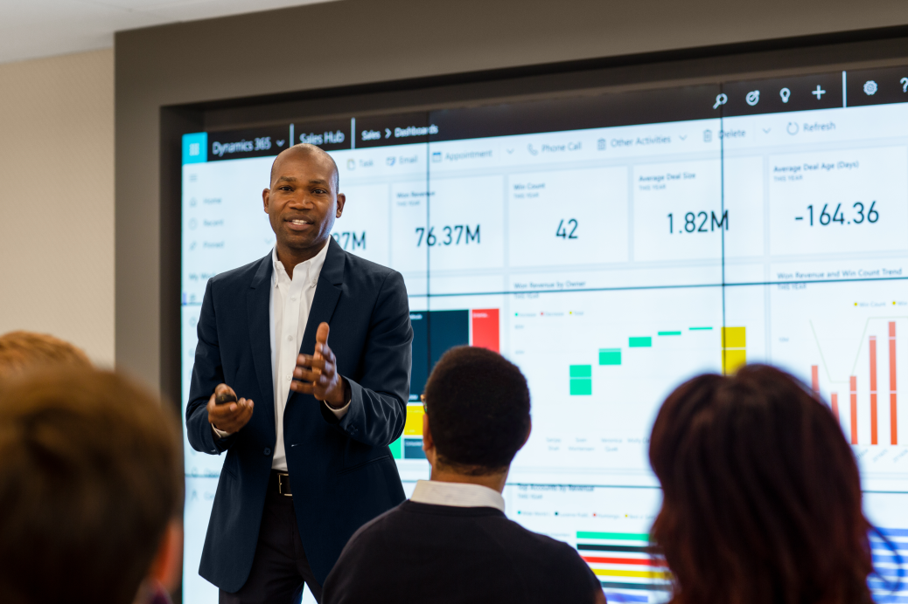
Power BI
Notes:
Power BI is the data analysis platform that is made up of a collection of software services, apps, and connectors that work together to turn your data from multiple unrelated sources of data into coherent, visually immersive, and interactive environment

Slide 36
Alerts & Approvals
Intelligent Plant Data Connector
Intelligent Q&A
Field Technician Power App
Data Storage
Custom Entity
Data
Views
Graphs
Dashboards
Forms
AI Builder
Turbine Analytics

Slide 37
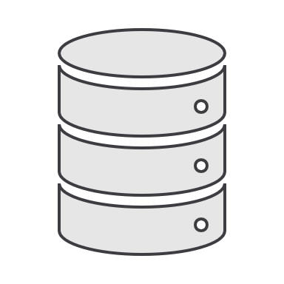
Business Area
Problem Statements
How do I leverage the data I collect on a regular basis?
App
Security
Integration
How do I enable my field workers to understand unstructured numbers?
Reports
Automation
Data scientists are too expensive to hire!
How do I streamline information reporting to a database?
There is too much unstructured data to deal with!
How do I keep my data available and safe?
How do I simplify the sharing of data knowledge across the organization?
Notes:
Once again Dave, who apparently never seems to stop complaining about his field workers, realises that in order to understand whether the one note flow he implemented is useful, he wants to see the statistics that show usage, completion rate of the flows and whether any new changes were implemented to it. This data is available under the shape of an excel spreadsheet with a list of all the executed flows since day one, that however require the addition of an extra column to be added manually with a formula, to display the completion rate and same for the usage. Why would Dave waste time doing this when he could simply click on a button that shows him a beautiful graph of this that can then be copied and pasted into his pretty presentation?

Slide 38

Wrap Up

Slide 39
Alert User via Email
Record Management Process
Record Management Canvas App
Record Management Model App
Power Apps
Dataverse
Custom Entity
Data
Views
Graphs
Dashboards
Forms
AI Builder
Data Management Report

Slide 40
Power Platform overview
Power BI
Business analytics
Power Apps
Application development
Power Automate
Process automation
Power Virtual Agents
Intelligent virtual agents
Canvas Apps
Microsoft Flows
Model-driven Apps
Business Process Flows
Portals
UI Flows (RPA)
Data connectors
Common Data
Service
AI Builder
Center of Excellence (Governance, Compliance & Security)
Notes:
.

Slide 42

Thank you

